Slide 1


Search-Based Software Refactoring
Marouane Kessentini
marouane@umich.edu
SBSE Research Lab, CIS Department,
College of Engineering and Computer Science
University of Michigan-Dearborn, MI USA
03/14/2018

Slide 2
SBSE-Michigan Research Lab
Design, adapt and evaluate intelligent computational search (optimization) and data analytics techniques to address large-scale software engineering problems
Refactoring and technical debt
Requirements engineering/Scheduling
Design and Model Transformation
Maintenance and Evolution
Testing (test cases generation, bugs localization, etc.)
Service-Oriented Architectures,
Mining software repositories
…

Slide 3
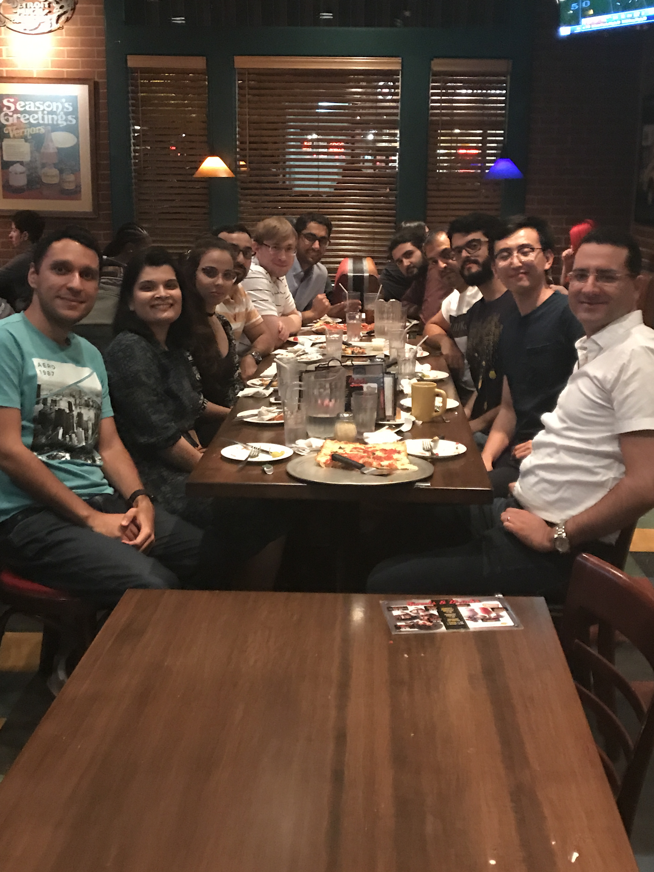










SBSE-Michigan Research Lab
Members
1 Faculty (me)
6 PhD Students
4 MSc Students
2 BSc Students
Academic and Industrial
partners:

Slide 4
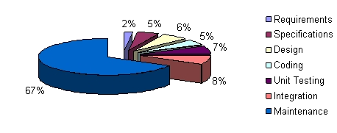
Software Evolution
Software Evolution activities
Bugs correction
Performance improvement
Environment migration
…
Challenges:
67% of Software Budget allocated to maintenance [Bhattacharya 2011]
76% of Software Engineers working on maintenance tasks [Jones 2006]
60% of Developers’ time in understanding existing software [Fowler 2002]
$60 Billion/year Economic cost of software bugs [NSIT 2002]
Solution:
Software Refactoring

Slide 5



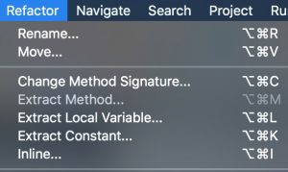

What is Refactoring?
“A change made to the internal structure of software to make it easier to understand and cheaper to modify without changing
its observable behaviour” – M. Fowler [1999]
Top-level menu in all modern IDEs
2

Slide 6
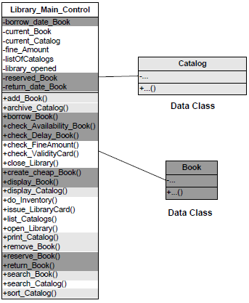
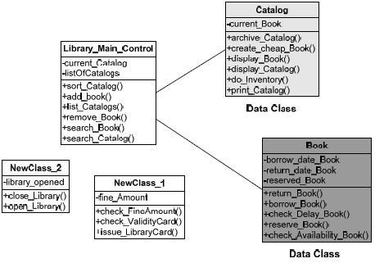
What is Refactoring?
Refactoring
Move method
Extract class
Move field
Add association
…
Blob

Slide 7
Code Antipatterns (Refactoring Opportunities)
Duplicated code
Long method
Large class
Long parameter list
Message chain
…
Switch statements
Data class
Functional decomposition
…
Brown, William J., McCormick III, Hays W. "Skip", Thomas, Scott W. AntiPatterns in project management. New York: Wiley, 2000.

Slide 8
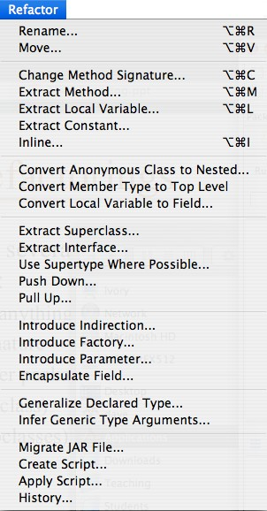
Refactoring Types

Slide 9
Tool Support
JAVA
Eclipse
IntelliJ IDEA
Borland JBuilder
NetBeans
RefactorIT plug-in for Eclipse, Borland JBuilder, NetBeans, Oracle JDeveloper
.NET
IntelliJ Resharper for Visual Studio .NET
Visual Studio .NET Team Studio 2005 (Forthcoming)

Slide 10
Refactoring Process
Make a small change
a single refactoring
Run all the tests to ensure everything still works
If everything works, move on to the next refactoring
If not, fix the problem, or undo the change, so you still have a working system

Slide 11
Extract Class
Break one class into two, e.g. Having the phone details as part of the Customer class is not a realistic OO model, and also breaks the Single Responsibility design principle. We can refactor this into two separate classes, each with the appropriate responsibility.
public class Customer
{
private String name;
private Phone workPhone;
}
public class Phone
{
private String areaCode;
private String number;
}
public class Customer
{
private String name;
private String workPhoneAreaCode;
private String workPhoneNumber;
}

Slide 12
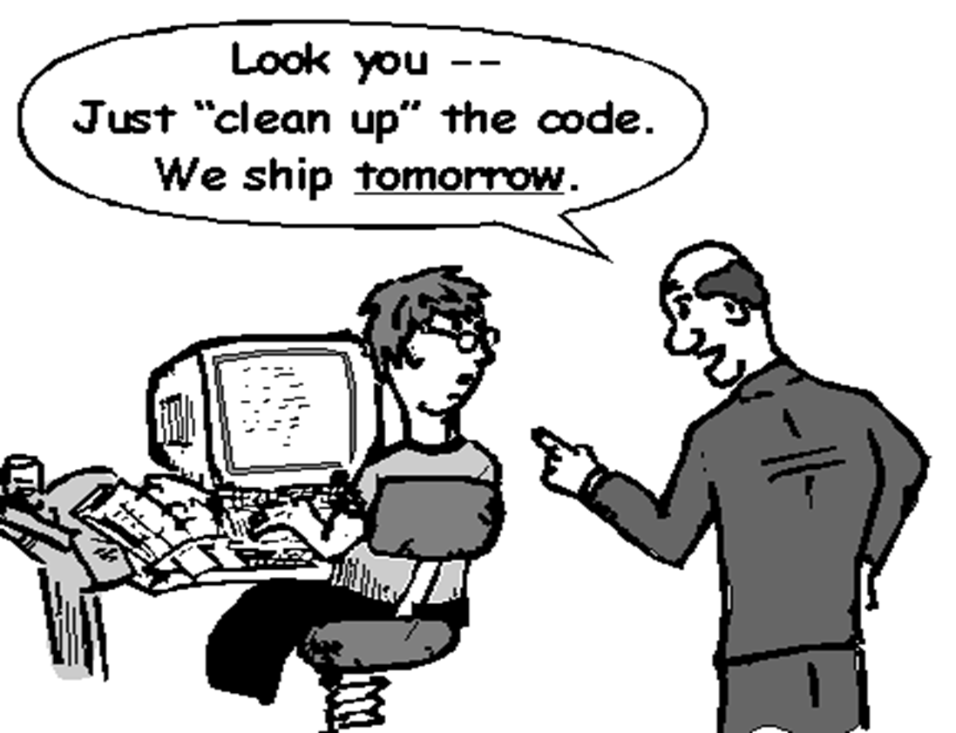
Refactoring Management…

Slide 13
Something to think about…
The longer you wait before paying your debt, the bigger the bill —common sense
The bigger the mess, the less you want to clean it up —Joshua Kerievsky
Perfection is reached not when there remains nothing to add, but when there remains nothing to remove —Antoine de Saint-Exupéry, 1900-1944

Slide 14
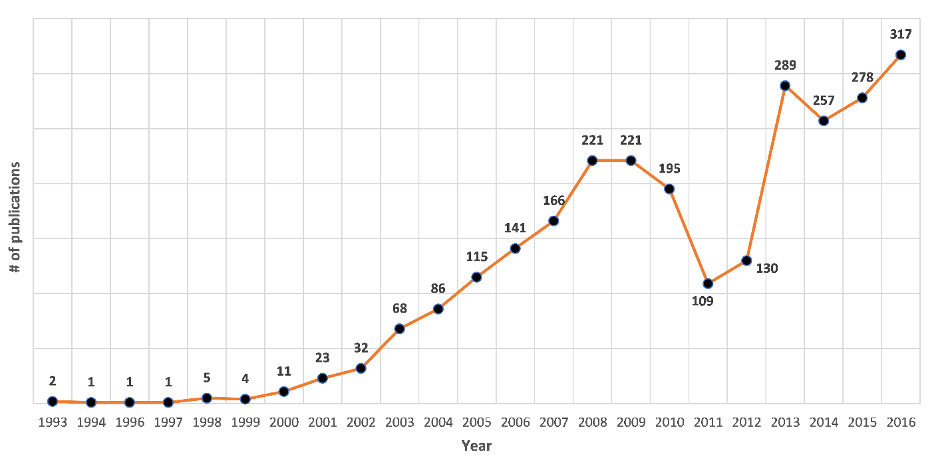

Refactoring research growth
2,880 refactoring papers (4,944 authors) since 1990

Slide 15
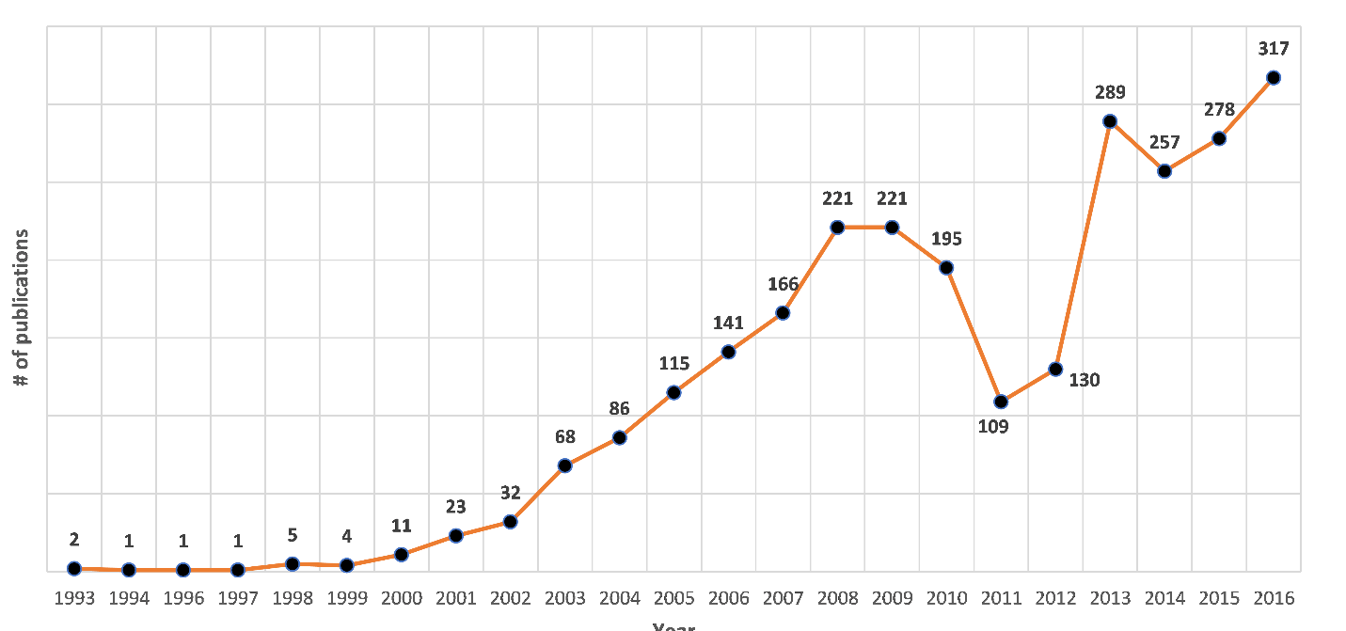
Most recent Decade of Refactoring Research
2,880 refactoring papers since 1990
2,442 papers between 2005-2016
T. Mens

Slide 16
Corpus of Papers
Scopus and Web of Science
"Refactoring” in title, abstract, and keywords
yielded 3277 papers
Refactoring definition:
transformation with behavior preservation
Manual validation of ALL papers:
each paper analyzed title, abstract (and sometimes content)
4 grad students who took a graduate class on Softw QA,
I looked at the contentious papers
In the end we removed 397 papers

Slide 17
O1: To Grow, Welcome Outsiders, Champions from Other Communities
823 citations
41 pubs

Slide 18
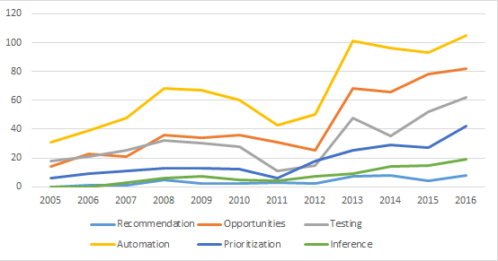
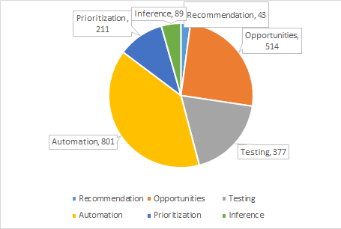
O2: To Grow, Expand Focus of Interest (the WHAT)
automating
insight testing prioritization
inference recommendation
Expand focus to meet new needs that you can serve

Slide 19
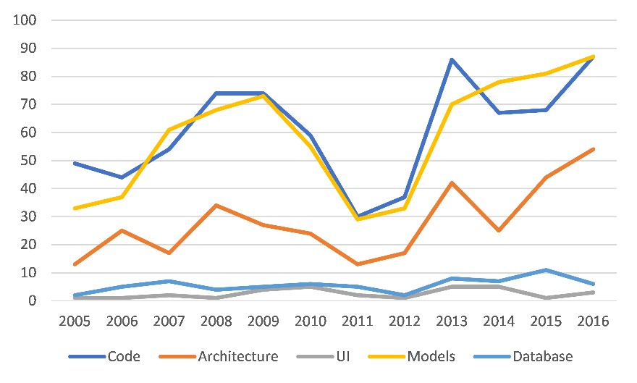
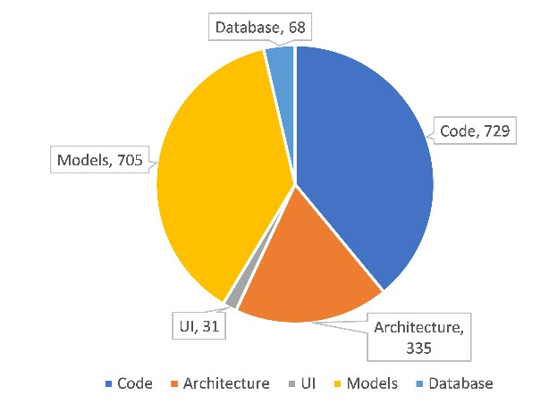
O3: To Grow, Expand the Target Artefacts
models code
architecture
DB
UI
Expand target: new refactoring research is about change to the code, models, architecture, DB, UI

Slide 20
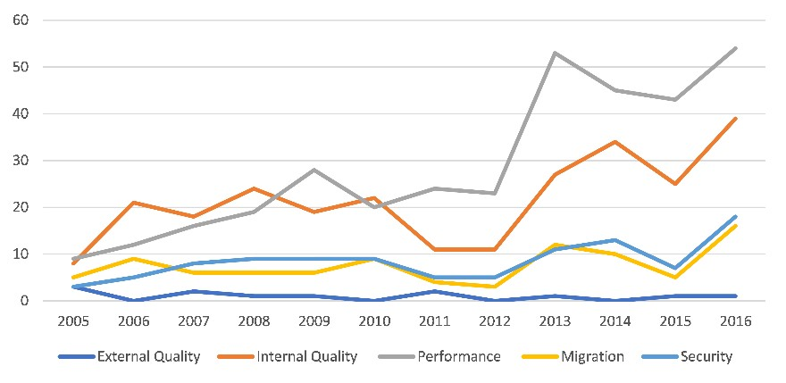
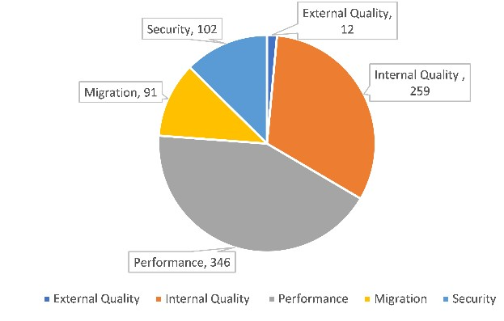
O4: To Grow, Expand Objectives (the WHY)
performance internal quality
security migration
Expand Objectives: new refactoring research is to improve performance, security, migration (beyond internal quality)
10

Slide 21
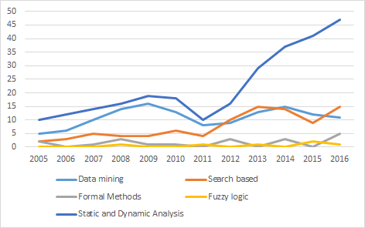
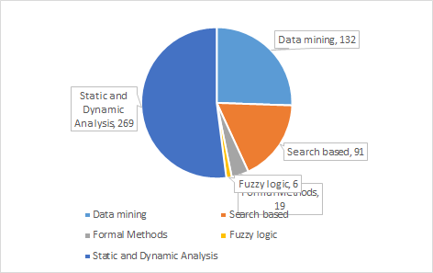
O5: To Grow, Adopt new Techniques (the HOW)
static & dynamic analysis
search-based data mining
New refactoring research via static analysis, search-based, data mining

Slide 22
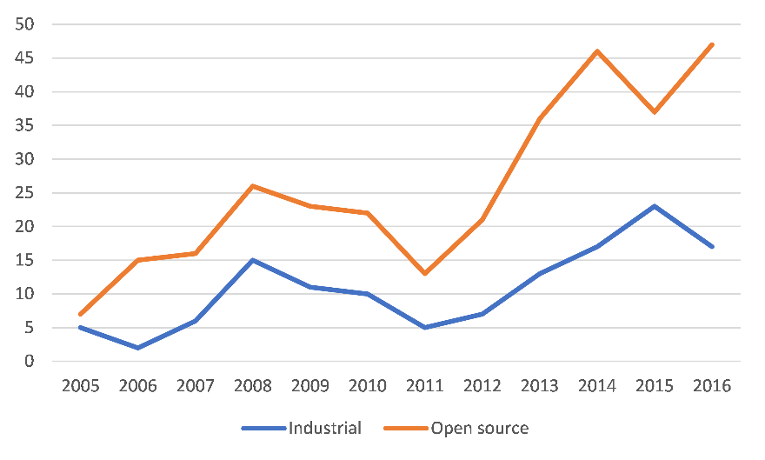
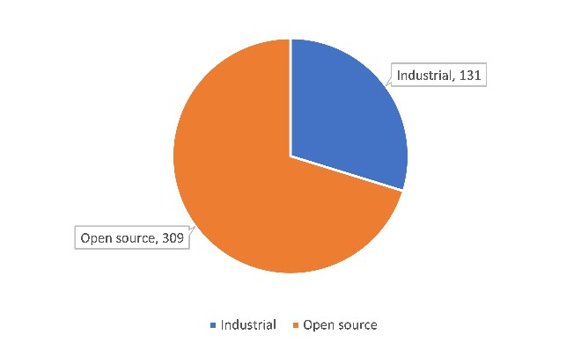
O6: To Increase Practical Impact, Work with Industry
Open-source data
industrial data
Industrial collaboration levels:
surveys with practitioners
tool validated on industrial codebase
tool licensed to industry, adopted in products

Slide 23
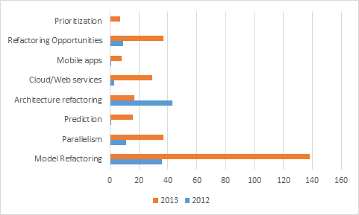
The Big Growth from 2012-2013

Slide 24
Big Growth of the Field: Expanding Definition
“A change made to the internal structure of software to make it easier to understand and cheaper to modify without changing its observable behaviour” – M. Fowler ‘99
Expanded Focus, Objectives,
Techniques
“Automation/insight/testing/prioritization of changes to the artifacts of software to improve non-functional requirements and without changing its proper, intended behaviour” – M. Kessentini ‘17
Communities that thrive are going to be more accepting of new ideas

Slide 25
Big Growth Enabled by Community Engineering
Industrial champion(s): M. Fowler, Kent Beck, Ward Cunningham
Complementary skills: tool builders, paper writers, curators Mindset for industrial collaboration and adoption
Shared platform:
Eclipse (Erich Gamma + Frank Tip), analysis frameworks
Community infrastructure: 7 Refactoring Workshops, Dagstuhl
50+ participants, 32 posters
invited all major IDE providers
growing new leaders

Slide 26
SBSE@Michigan Our Recent Advances on Search-Based Refactoring (2014-2016)
Automated Refactoring Recommendation: TOSEM16, IST16, JSS15a, ESE15, …
Refactoring Model Transformations:
TSE16, MODELS16,…
Code Smells Detection:
TOSEM15a, TSE14, …
Software Remodularization: TOSEM2015b, …
Refactoring Web Services:
ICWS16, ICSOC16a, SERVICES16, TSC15, GECCO15,….
Interactive Refactoring:
ASE14, …
Search-Based Software Engineering
Refactorings Detection: ESE16,JSS15c, ….
Refactoring Prioritization:
ESE16,SQJ15, …
Model Refactoring:
JSME16, SQJ16, SQJ15,JSME15a, …
Merging Refactorings:
JSS15b, ICSM14,…
Regression Testing for Refactoring:
ASE16, JSME15b
Refactoring Prediction: ICSOC16b, MEDES15, SSBSE14,…

Slide 27
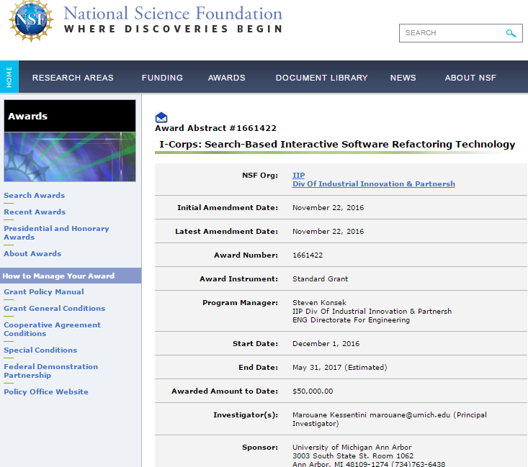
SBSE@Michigan Our Recent Advances on Search-Based Refactoring (2014-2016)
Automated Refactoring Recommendation: TOSEM16, IST16, JSS15a, ESE15, …
Refactoring Model Transformations:
TSE16, MODELS16,…
Code Smells Detection:
TOSEM15a, TSE14, …
Software Remodularization: TOSEM2015b, …
Refactoring Web Services:
ICWS16, ICSOC16a, SERVICES16, TSC15, GECCO15,….
Interactive Refactoring:
ASE14, …
Refactorings Detection: ESE16,JSS15c, ….
Refactoring Prioritization:
ESE16,SQJ15, …
Model Refactoring:
JSME16, SQJ16, SQJ15,JSME15a, …
Merging Refactorings:
JSS15b, ICSM14,…
Regression Testing for Refactoring:
ASE16, JSME15b
Refactoring Prediction: ICSOC16b, MEDES15, SSBSE14,…

Slide 28
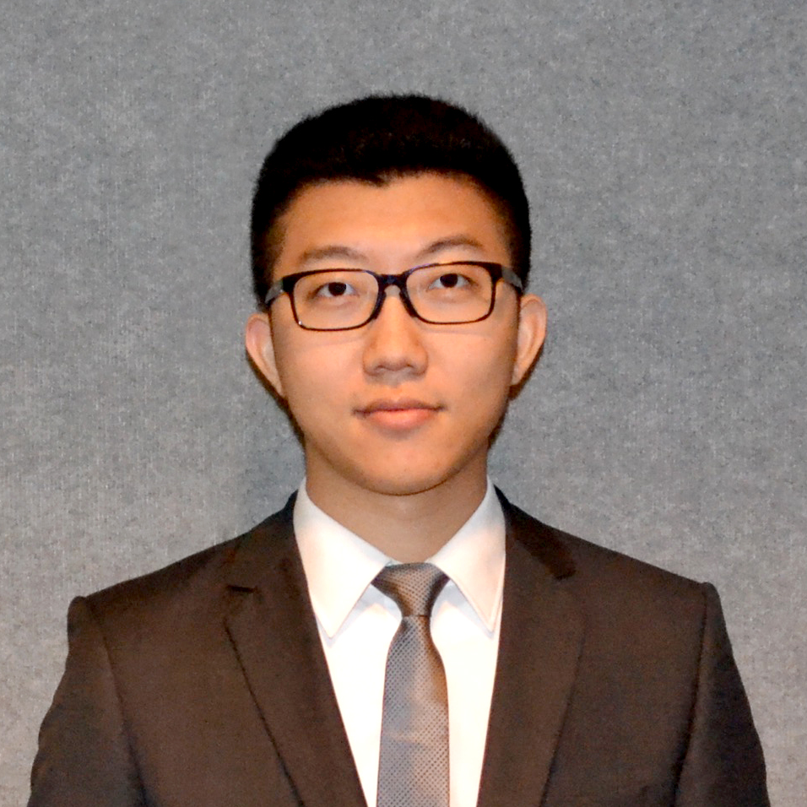

Interactive Software Refactoring
Technology
Business thesis: “Our software maintenance tool helps developers team managers of real-time legacy systems who want to reduce development cost (10%-30%) by automatically providing solutions to fix their software design defects.”
Interviews | In Person | Video Chat | Phone | Total
Total | 78 | 16 | 6 | 100
Team 887
Hanzhang Wang
EL
Marouane Kessentini
PI
Michael Monan
Industry Mentor

Slide 29
Why Search-Based Refactoring?
Realistic refactoring solutions
Conflicting quality metrics
Subjective software design evaluation
Generic refactoring solutions
Different levels of abstraction
Different languages
Robust refactoring solutions
Uncertainties around estimating refactoring benefits and cost
Scalable refactoring solutions
Combinatorial number of possible refactoring combinations

Slide 30




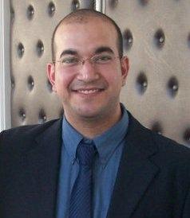

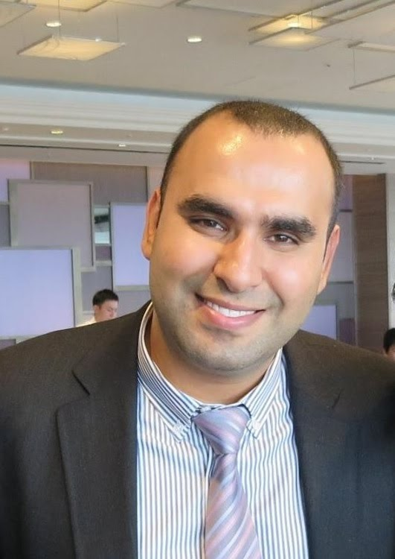














Search-Based Refactoring

Slide 31
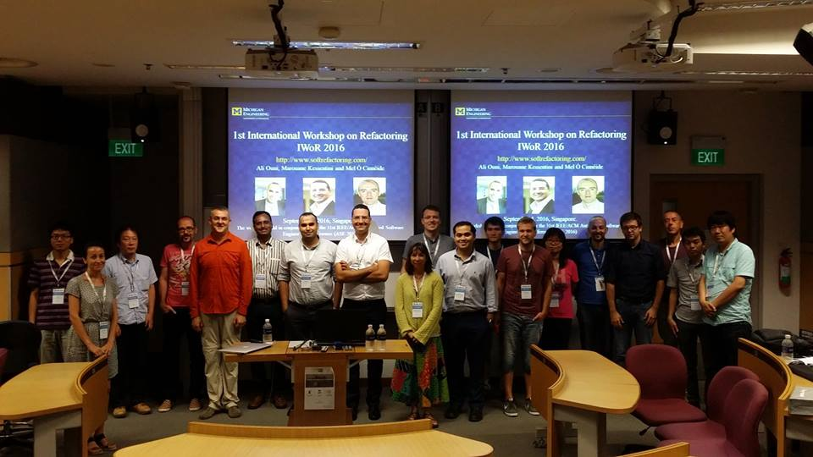
1st International Workshop on Refactoring IWoR 2016

Slide 32
Existing work Refactoring Challenges
Software Refactoring
Manual Refactoring
Fully-Automated Refactoring
Human-based techniques
Analyse source code for bad fragments and manually apply suitable sequence of refactorings (Fowler et al. ’02)
Analytic approaches
Study of relations between some quality metrics and refactoring changes (Sahraoui et al. ’00, Du Bois et al. ’08, Moha et al. ’12)
Search-based techniques
Find the best sequence of refactorings (O’Keeffe et al. ’06, Harman et al. ’07)
error-prone
time consuming
not scalable
not useful for radical refactoring (extensive application of refactorings to correct unhealthy code)
lacks flexibility (developers have to accept the entire refactoring solution)
fails to consider developer perspective and feed-back
proposes a long static list of refactorings to be applied but developers do not have enough time to apply all of them

Slide 33
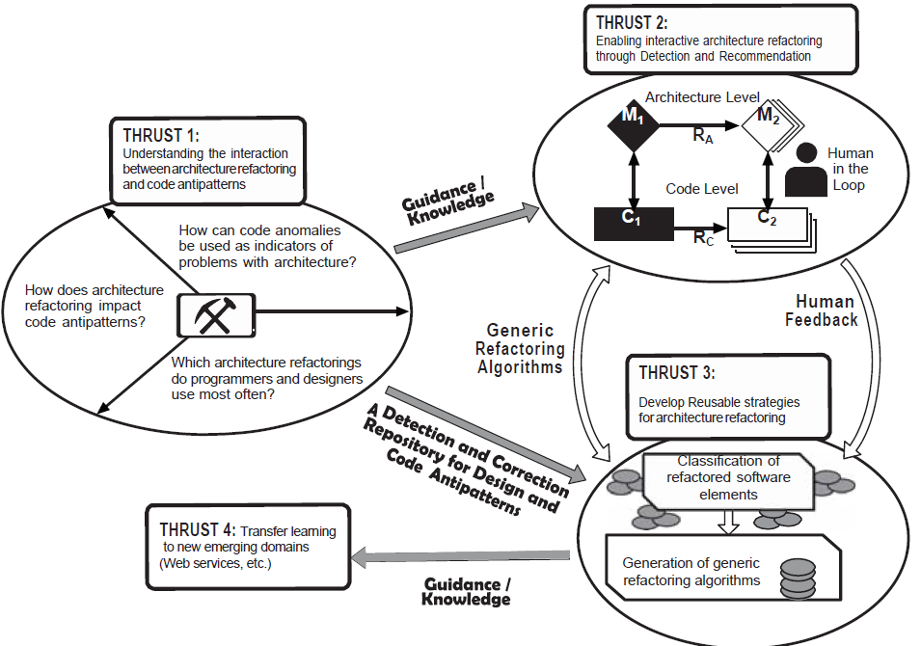
Our Refactoring Research Prototype

Slide 34
Interactive Refactoring Framework

Slide 35
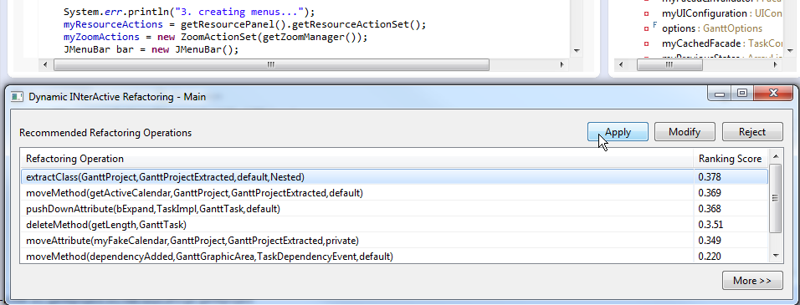

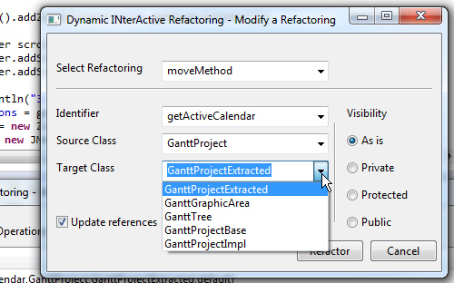
Dynamic Interactive Refactoring
Online Phase
Offline Phase
New search constraints:
List of accepted, modified
and rejected refactorings
Ranked list of Refactorings
Interactive NSGA-II to generate refactoring solutions:
Objective1: Improve the quality
Objective2: Reduce the number of refactorings
Dynamic update of refactorings ranking
Pareto front of best
refactoring solutions
Developers action
(Accept/Modify/Reject refactoring)
Solutions Ranking based on the most common features between them
A list of
ranked refactorings
from the best solution
Notes:
As a response to code smells, refactoring modifies software architecture to improve its quality by removing code smells without changing its functional behavior.

Slide 36
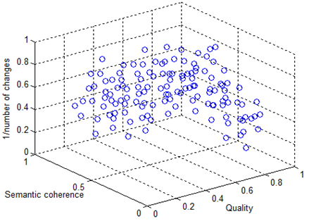
Multi-Objective Refactoring
Upfront generation of refactoring solutions using NSGA-II

Slide 37
NSGA-II Overview
NSGA-II: Non-dominated Sorting Genetic Algorithm (K.‎ Deb et al., ’02)
Non-dominated sorting
Objective 2
Front F1
F1
Population in next generation
Parent Population
F2
F3
Offspring Population
Front F2
F4
Intra-front sorting
Front F3
Objective 1

Slide 38
SBSE is so generic…
Software Engineering
Software Engineering Problem
Solution representation
encoding
Optimization
Techniques
Fitness
Function
Function defined to evaluate solutions
Search Based
Software Engineering
Change operator
Search Problem

Slide 39
Representation of Individuals
Individual = Refactoring solution
Sequence of refactoring operations
RO1 | moveMethod
RO2 | pullUpAttribute
RO3 | extractClass
RO4 | inlineClass
RO5 | extractSuperClass
RO6 | inlineMethod
RO7 | extractClass
RO8 | moveMethod

Slide 40
Representation of Individuals
Specify the controlling parameters
Random selection for the initial population
Refactorings | Controlling parameters
move method | (sourceClass, targetClass, method)
move field | (sourceClass, targetClass, field)
pull up field | (sourceClass, targetClass, field)
pull up method | (sourceClass, targetClass, method)
push down field | (sourceClass, targetClass, field)
push down method | (sourceClass, targetClass, method)
inline class | (sourceClass, targetClass)
extract class | (sourceClass, newClass)

Slide 41
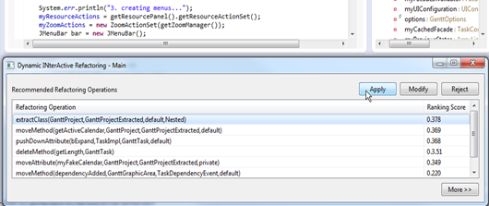
Interactive Recommendation
Interactive recommendation of refactorings
The list of ranked Refactorings recommended by DINAR

Slide 42
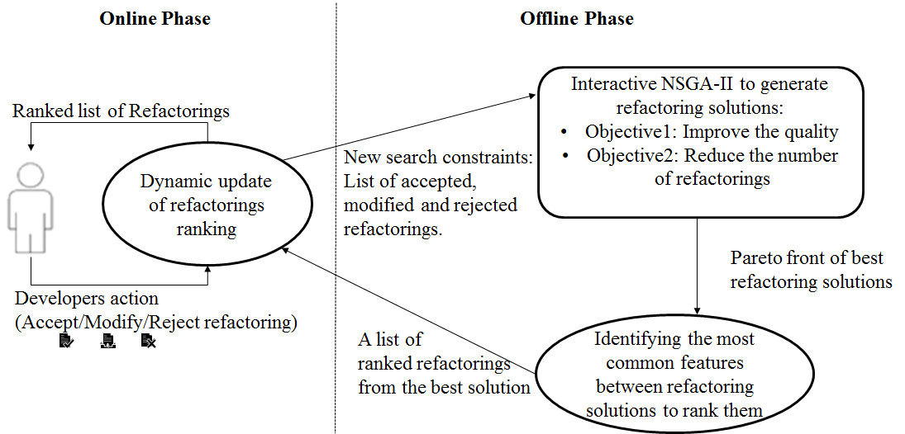
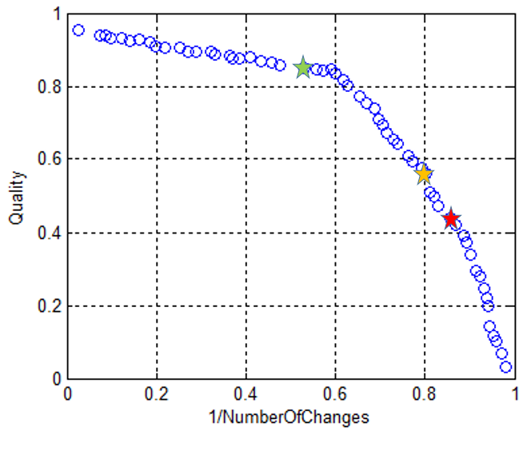
Running example
Pareto Front
3 solutions extracted
Solution1 fitness scores before normalization (0.198, 3)
Move Method | ctrl.booking.BookingController::handleLodgingViewEvent(java.awt.event.ActionEvent):void | ctrl.booking.LodgingModel | 0.4165
Extract Class | ctrl.booking.SelectionModel:: - flightList + addFlight():void +clearFlight():void | ctrl.booking.FlightList | 0.2915
Move Method | ctrl.booking.BookingController::createBookings():void | gui.components.DateEdit | 0.0525
Solution1 Rank |  |  | 0.7605
Solution2 fitness scores before normalization (0.202, 4)
Move Method | ctrl.booking.BookingController::handleLodgingViewEvent(java.awt.event.ActionEvent):void | ctrl.booking.lodgingList | 0.4025
Move Method | gui.panels.maintenance.mLodgingsPanel::getStart():java.util.Date | gui.components.LabelCombo | 0.4025
Inline Class | ctrl.ModelChangeEvent | ctrl.CoreModel | 0.0555
Extract Class | ctrl.booking.SelectionModel:: - travelerList + addTraveler():void +clearTraveler():void | ctrl.booking.TravelerList | 0.4165
Solution2 Rank |  |  | 1.2770
Solution3 fitness scores before normalization (0.209, 5)
Extract Class | ctrl.booking.SelectionModel:: - flightList + addFlight():void +clearFlight():void | ctrl.booking.FlightList | 0.2915
Move Method | ctrl.booking.BookingController::handleLodgingViewEvent(java.awt.event.ActionEvent):void | ctrl.booking.lodgingList | 0.4025
Extract Class | ctrl.booking.SelectionModel:: - travelerList + addTraveler():void +clearTraveler():void | ctrl.booking.TravelerList | 0.4165
Inline Class | ctrl.ModelChangeEvent | ctrl.CoreView | 0.0555
Move Method | gui.panels.maintenance.mLodgingsPanel::getStart():java.util.Date | ctrl.CoreModel | 0.0025
Inline Class | ctrl.ModelChangeEvent | ctrl.Core | 0.0025
Solution3 Rank |  |  | 1.1710
Notes:
As a response to code smells, refactoring modifies software architecture to improve its quality by removing code smells without changing its functional behavior.

Slide 43
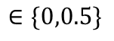
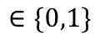
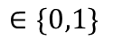
Running example
Refactoring operation ranking:
Dynamic solution ranking:
$$∈\{0,1\}$$
$$∈\{0,0.5\}$$
$$∈\{0,1\}$$
Initial rank
Dynamic rank
Initial Ranking:
 | Initial Rank | Interaction1 | Interaction2 | Interaction3 | Interaction4
Solution1 | 0.7605
Solution2 | 1.2770
Solution3 | 2.1710
Notes:
As a response to code smells, refactoring modifies software architecture to improve its quality by removing code smells without changing its functional behavior.

Slide 44
Experiments and Qualitative Evaluation
Scenario1: Recorded changes for manually fixing code smells (9 classes per system)
Scenario2: Cross validation to calculate Manual Correctness
Scenario3: Post-study questionnaire
Scenario4: 2 bugs to fix
Scenario5: 2 features to add
Subject groups | Systems | Algorithms / Approaches
Group A | Xerces-J | Interactive NSGA-II (Kessentini, et al., 2011) (O’Keeffe, et al., 2008) | (Ouni, et al., 2012) (Harman, et al., 2007) JDeodorant (Fokaefs, et al., 2011)
 | JHotDraw
 | JFreeChart
 | GanttProject
Group B | Apache Ant | Interactive NSGA-II (Kessentini, et al., 2011) (O’Keeffe, et al., 2008) | (Ouni, et al., 2012) (Harman, et al., 2007) JDeodorant (Fokaefs, et al., 2011)
 | Rhino
 | Log4J
 | Nutch
Group C | JDI-Ford | Interactive NSGA-II (O’Keeffe, et al., 2008), (Ouni, et al., 2012), JDeodorant (Fokaefs, et al., 2011)
 | MROI-Ford

Slide 45
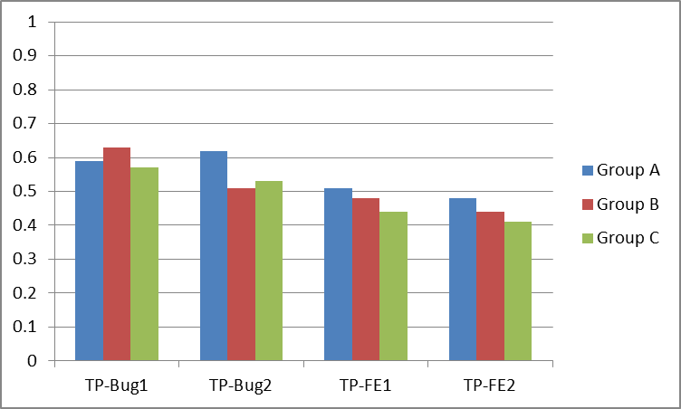
Results
Impact on Productivity
RQ Can our approach help developers to find useful refactorings quickly?
Average Productivity Difference (TP)

Slide 46
Industrial Case Study: Ford Motor Company
8 software engineers from Ford evaluated the detected defects on the JDI System
Sahin Dilan, Marouane Kessentini, Slim Bechikh and Kalyanmoy Deb. “Code-Smell Detection as a Bilevel Problem." ACM Transactions on Software Engineering and Methodology (TOSEM), Vol 24, no. 1, pp 1-45, ACM, 2015.
Kessentini Wael, Marouane Kessentini, Houari Sahraoui, Slim Bechikh, and Ali Ouni. “A Cooperative Parallel Search-Based Software Engineering Approach for Code-Smells Detection." IEEE Transactions on Software Engineering (TSE), Vol 40, Issue 9, pp 841-861, IEEE, (2014).

Slide 47
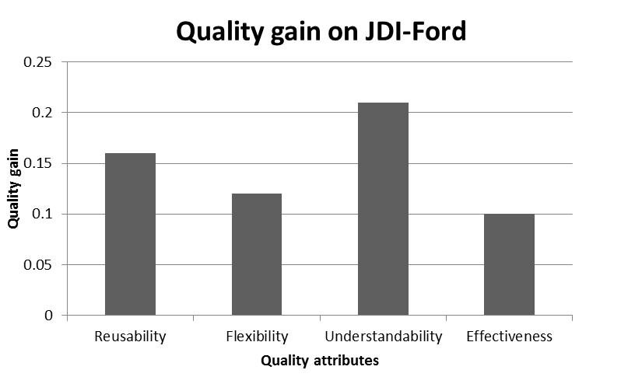
Quality Gain

Slide 48
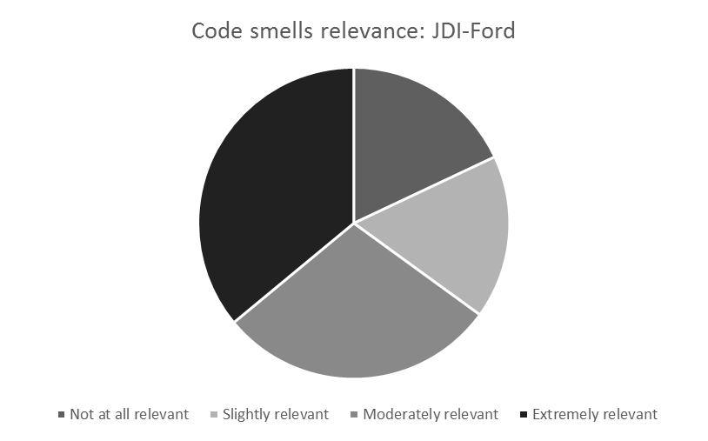
Code Smells Relevance

Slide 49
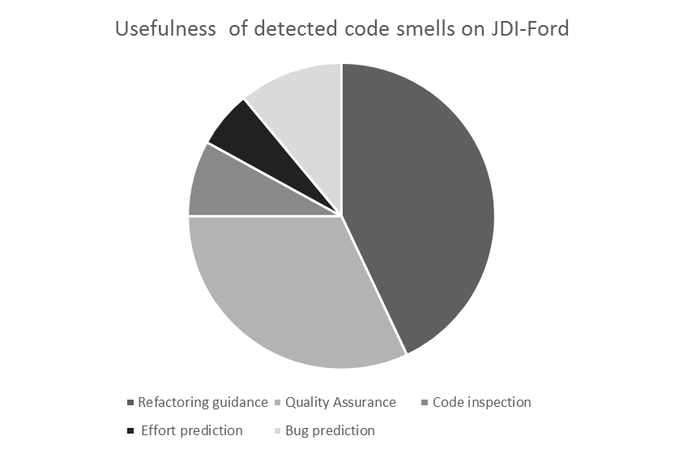
Usefulness of Code Smells

Slide 50
Results: Feed-back from Developers
The participants agreed that
the interactive dynamic refactoring recommendations are a desirable feature in IDEs
the interactive manner of recommending refactorings by our tool is a useful and flexible way to refactor systems comparing to fully-automated or manual refactorings
The participants found the tool helpful
for both floss refactoring and root canal refactoring
to modify the source code (to add new functionality) while doing refactoring
to take the advantages of using multi-objective optimization for software refactoring without the explicit exploration of the set of non-dominated solutions

Slide 51
Java Refactoring Tool Demo !

Slide 52
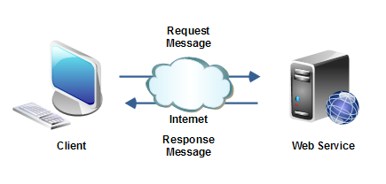

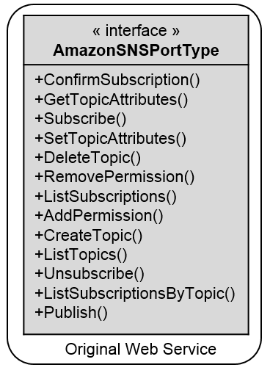
Web Service Quality
Source Code
Quality of Service (QoS)
Web Service Description
(e.g. WSDL)

Slide 53



State-of-the art
Manual approaches/guidelines
Service antipatterns definition (Dudney et al., 2003, Král et al, 2009, Rotem-Gal-Oz et al., 2012)
Symptoms-based approaches
Detection rules (Moha et al., 2012, Palma et al., 2014)
Translate antipattern symptoms into detection rules
Combination metrics/threshold value
53
Notes:
Towards a catalog of Web service antipatterns

Slide 54
Our Recent Services Design Contributions
Prediction of
Design Defects
Automated
Defect Detection
Design History
MEDES 15’, ICWS 17’
Detection of Web Service
Design Defects
Detection of Changes
Among Service Releases
Evolution
Prediction
ICSOC 16’, ICWS 16’ ICWS 17’
ICWS 17’
Automated
Defect Detection
Recommendation of
Web Service Refactoring
Change History
ICWS 17’, ICSOC 17’, TSC 18’
Existing Service
Refactored
Service Design
Machine Learning
Automated Search
Interactive Method

Slide 55



Web Service Antipatterns
Flight Reservation Service
+ bookFlight() + reserveFlight()
Client 1
TravelService Endpoint
+ bookFlight() + reserveFlight() + cancelFlight() + reserveCar() + cancelCar() + reserveHotel() + checkDates() + modifyBooking() + acceptPayment() + addPaymentDetails() + validateCredit() + printInvoice() + sendInvoice() …
Client 2
Client 3
Flight Cancellation Service
+ cancelFlight() + cancelPayment()
Flight Change Service
+ changeFlight() + searchFlight()
Client 4
Client n
Fine-grained Service
God-object Service
Few operations
High coupling
High development complexity
Reduced usability
Many operations
Low cohesion
High response time
Low availability
Not easily reusable
Notes:
Web Service Antipatterns
They are patterns associated with bad design and programming practices and violations of quality principles
Bug rate, fragile design, inflexible code
Usability, understandability, maintainability

Slide 56
Real-World Example
Amazon EC2
« interface » AmazonEC2portType
CreateImage() RegisterImage() DeregisterImage() DescribeImages() RunInstances() TerminateInstances() DescribeInstances() MonitorInstances UnmonitorInstances DescribeReservedInstances GetPasswordData() CreateSecurityGroup() DeleteSecurityGroup() DescribeSecurityGroups AuthorizeSecurityGroupIngress() RevokeSecurityGroupIngress() AllocateAddress() ReleaseAddress() DescribeAddresses() AssociateAddress() DisassociateAddress() CreateVolume() DeleteVolume() DescribeVolumes() AttachVolume() DetachVolume() CreateSnapshot() DeleteSnapshot() ModifySnapshotAttribute() ResetSnapshotAttribute() . . .
Client 1
Image management.xml
Client 2
87 operations in one single interface
4,261 lines of WSDL document
812 pages of API documentation
Security management.xml
Client 3
Volume management.xml
Instances management.xml
Client 4
.
.
.
Snapshot management.xml
Client n

Slide 57
Web Service Refactoring
Example
Application Releases
Application Ver 1
GetObjectAccessControlPolicy() GetBucketAccessControlPolicy() GetBucketLoggingStatus() SetBucketLoggingStatus()
Remodularized Interface
Original Interface
AmazonS3 – AccessManage
+GetBucketAccessControlPolicy() +SetBucketAccessControlPolicy() +GetObjectAccessControlPolicy() +SetObjectAccessControlPolicy() +GetBucketLoggingStatus() +SetBucketLoggingStatus()
AmazonS3
+CopyObject() +CreateBucket() +PutObject() +GetObjectAccessControlPolicy() +GetBucketAccessControlPolicy() +GetBucketLoggingStatus() +SetBucketLoggingStatus() +ListAllMyBuckets() +DeleteBucket() +ListBucket() +PutObjectInline() +GetObject() +DeleteObject() +GetObjectExtended() +SetBucketAccessControlPolicy() +SetObjectAccessControlPolicy()
After 376 days
Application Ver 4
GetObjectAccessControlPolicy() GetBucketAccessControlPolicy() GetBucketLoggingStatus() SetBucketLoggingStatus() DeleteBucket() ListBucket()
Remodularized
AmazonS3 - BucketManage
+CreateBucket() +DeleteBucket() +ListBucket() +ListAllMyBuckets()
New Invocations
After 112 days
Application Ver 11
GetObjectAccessControlPolicy() GetBucketAccessControlPolicy() GetBucketLoggingStatus() SetBucketLoggingStatus() DeleteBucket() ListBucket() GetObject() DeleteObject() GetObjectExtended()
AmazonS3 - ObjectManage
+GetObject() +PutObject () +CopyObject() +DeleteObject() +GetObjectExtended() +PutObjectInline()
New Invocations
Web Service Structure
Remodularized Web Service Structure

Slide 58
Antipattern Types
God object Web service (GOWS)
Fine grained Web service (FGWS)
Chatty Web service (CWS)
Data Web service (DWS)
Ambiguous Web service (AWS)
Redundant PortTypes (RPT)
CRUDy Interface (CI)
Maybe It is Not RPC (MNR)

Slide 59
Web Service Metrics
Metric Name | Definition
NPT | Number of port types
NOD | Number of operations declared
NAOD | Number of accessor operations declared
NOPT | Average number of operations in port types
ANIPO | Average number of input parameters in operations
ANOPO | Average number of output parameters in operations
NOM | Number of messages
NBE | number of elements of the schemas
NCT | Number of complex types
NST | Number of primitive types
NBB | Number of bindings
NBS | Number of services
NPM | Number of parts per message
NIPT | Number of identical port types
NIOP | Number of identical operations
COH | Cohesion
COU | Coupling
AMTO | Average meaningful terms in operation names
AMTM | Average meaningful terms in message names
AMTMP | Average meaningful terms in message parts
AMTP | Average meaningful terms in port-type names
ALOS | Average length of operations signature
ALPS | Average length of port-types signature
ALMS | Average length of message signature

Slide 60
Genetic Algorithm/Programming
START
Population of solutions
Key elements
Representing of candidate solution
Definition of fitness function
Definition of genetic operators
Generate initial population
Evaluation
Optimal or “good” solution found ?
Yes
No
END
Selection
Detection rules
Crossover
Mutation

Slide 61
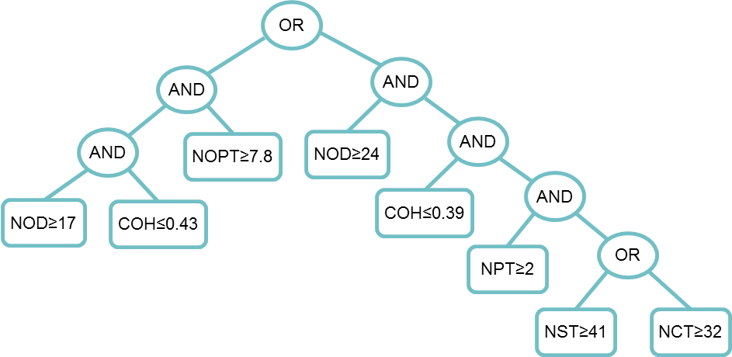
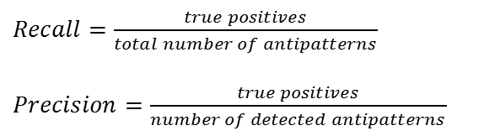
GP adaptation
Solution representation
Base of examples
Quality metrics
antipattern instance
NST
[1..200]
NOPT
NOD
COH
[1..150]
NCT
Genetic Programming (GP)
IF (NOD(s)≥21 AND COH(s)≤0.32 AND NOPT(s)≥7.8) OR (NOD(s)≥24 AND COH(s)≤0.2 AND NPT(s)≥3 AND NST(s)≥41 OR NCT(s)≥32)
THEN GodObjectService(s)
Fitness function
$Recall=\frac{true positives}{total number of antipatterns}$
$Precision=\frac{true positives}{number of detected antipatterns}$

Slide 62
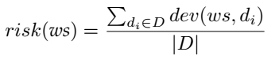
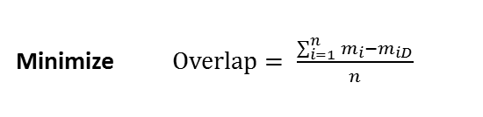
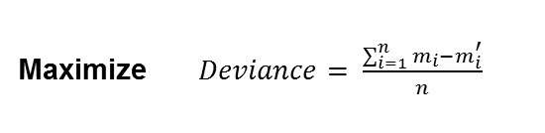
GA adaptation
Solution representation
Base of examples
Quality metrics
antipattern instance
NST
[1..200]
NOPT
NOD
COH
[1..150]
NCT
Genetic Algorithm (GA)
NOD=9 | COH=0.2 | NPT=1 | CBO=6 | … | NST=12
Maximize $Deviance= \frac{\sum_{i=1}^{n}{m_{i}−m_{i}^{′}}}{n}$
Fitness function
Minimize $Overlap= \frac{\sum_{i=1}^{n}{m_{i}−m_{iD}}}{n}$
Maximize the distance of the detectors from the antipattern instances

Slide 63
Cooperative Parallel Formulation
(P-EA)
Genetic Programming
(GP)
Genetic Algorithm
(GA)
NOD=9 | COH=0.2 | NPT=1 | CBO=6 | … | NST=12
Intersection
The detectors generated by the GA should not be detected by the detection rules generated by GP
Notes:
These two algorithms run in parallel in a cooperative manner
First, GP generates detection rules, and GA generates artificial Web services that represent good design practices…
Then the intersection between them is

Slide 64
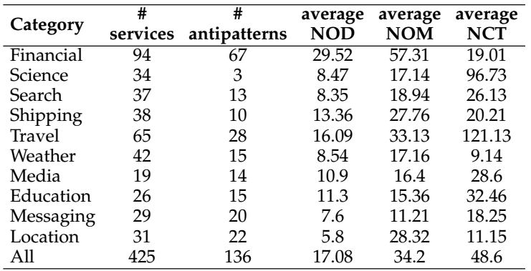
Evaluation
Studied Web services
Benchmark of 425 Web services
Dataset: https://github.com/ouniali/WSantipatterns

Slide 65
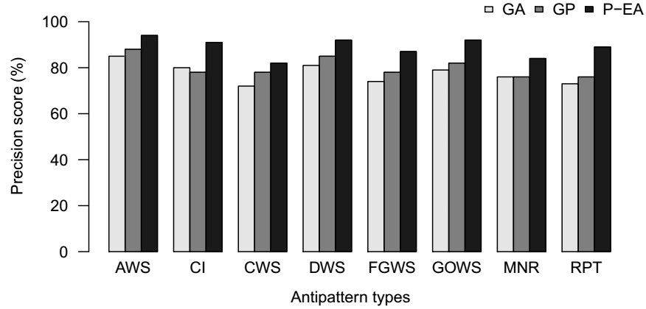
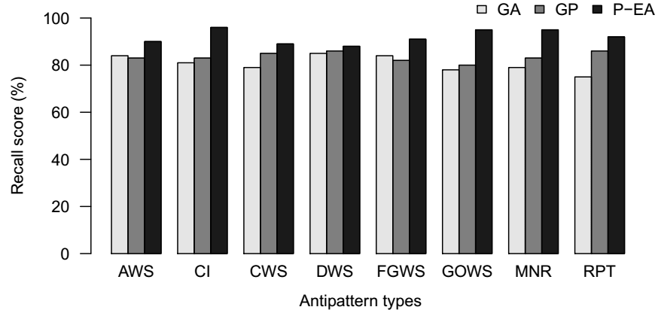
Results
Detection Precision
Detection Recall

Slide 66

Reflections and Lessons

Slide 67


L1: Work in Your Strength Zone but
Reinvent Yourself
Mobile
-energy efficiency
Object-Oriented Design
improve quality
Technical debt management
improve scalability
Refactoring
Service-Oriented Architectures
Model Driven Engineering
- Automated migration
improve design quality
Technical debt management
improve performance
programs
Principles for changing between different programming domains and models

Slide 68



L2: Find Your Dream and then Live It
Automating Refactoring
-ship with official
Detection of antipatterns
- dozen labs
- hundreds of accepted patches
founded Workshop on Refactoring
Refactoring
- first interactive refactoring framework
Understanding
- shaped APIs in Java and included .NET official libraries
Testing

Slide 69

L3: Proactively Look for Opportunities, but Be Flexible
Expected Company
Actual Company
Expected Target
Actual Target
Refactoring
Refactoring
MROI
Scheduling optimization

Slide 70

L4: To Grow Others, Grow Yourself
Do you have a plan for your personal growth?
How do you get better at what you do?
How do you improve your relationships?
How do you gain insight?

Slide 71
Search-Based Software Refactoring
Marouane Kessentini
marouane@umich.edu
SBSE Research Lab, CIS Department,
College of Engineering and Computer Science
University of Michigan-Dearborn, MI USA
03/14/2018

